Slide 1
Object Detection using Deep Learning- Data Preparation - Augmentation

Slide 2
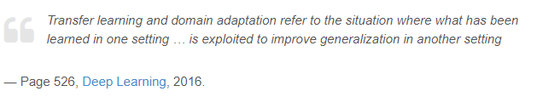
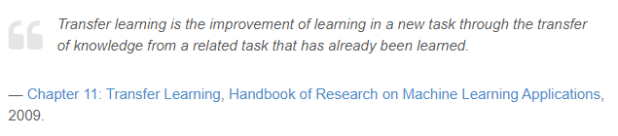
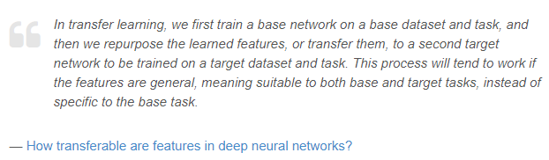
Transfer Learning
What is Transfer Learning?
https://machinelearningmastery.com/transfer-learning-for-deep-learning/

Slide 3
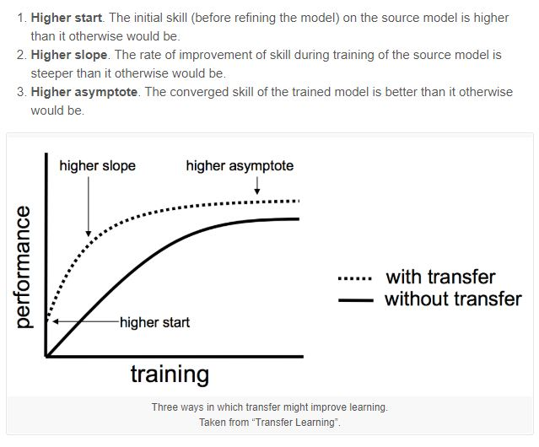
Transfer Learning
When to Use Transfer Learning?
https://machinelearningmastery.com/transfer-learning-for-deep-learning/

Slide 4
Transfer Learning
Types of Transfer Learning?
In general, there are two types of transfer learning when applied to deep learning for computer vision:
1. Treating networks as arbitrary feature extractors.
2. Removing the fully-connected layers of an existing network, placing new FC layer set on top of the CNN, and fine-tuning these weights (and optionally previous layers) to recognize object classes.
https://machinelearningmastery.com/transfer-learning-for-deep-learning/

Slide 5
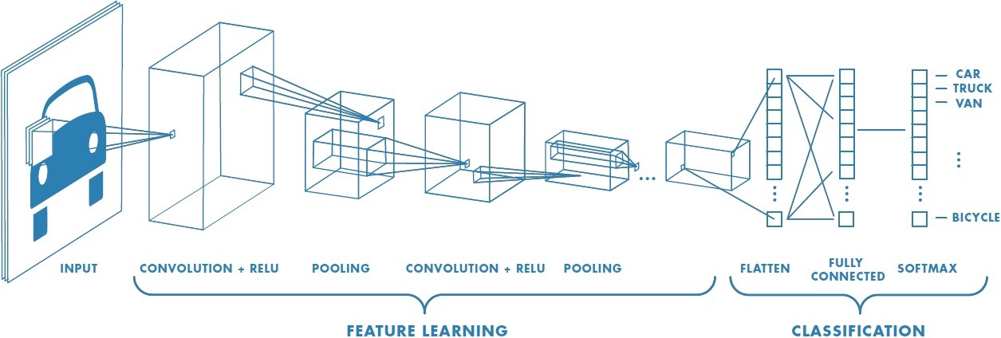
Networks as Feature Extractors

Slide 6
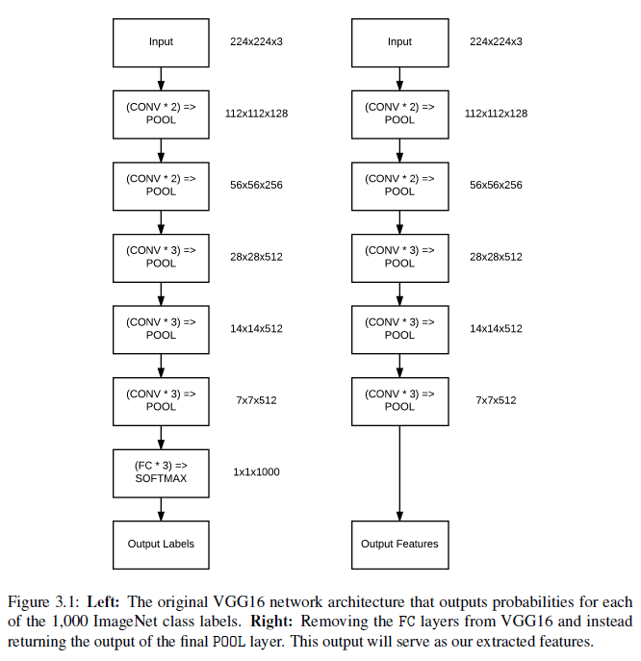
Networks as Feature Extractors

Slide 7
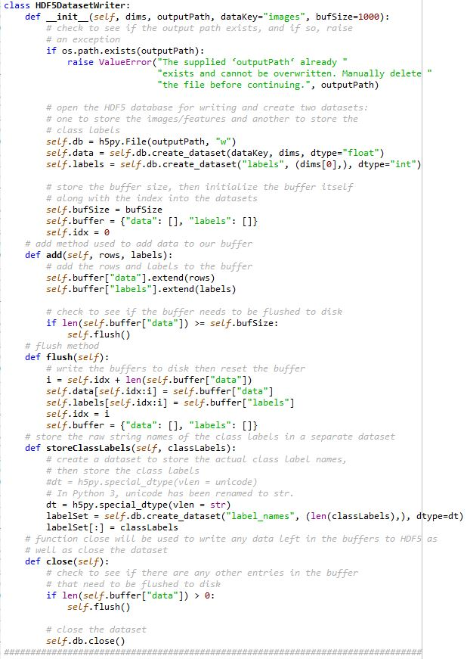
Networks as Feature Extractors
Extracting Features with a Pre-trained CNN
1. Writing Features to an HDF5 Dataset

Slide 8
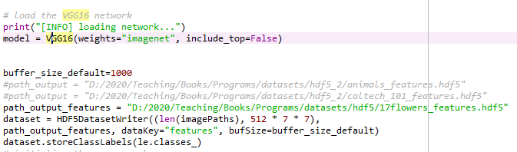
Networks as Feature Extractors
Extracting Features with a Pre-trained CNN
2. The Feature Extraction Process

Slide 9
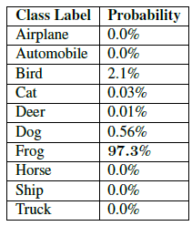
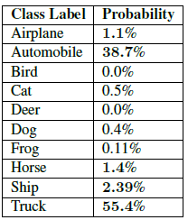
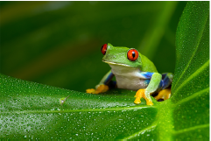

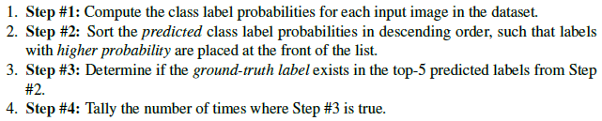
Networks as Feature Extractors
Extracting Features with a Pre-trained CNN
3. Ranked Accuracy: rank 1 and rank 5
input image of a frog that our neural network will try to classify
input image of a car that our neural network will try to classify
Rank 1:
Rank 5:

Slide 10
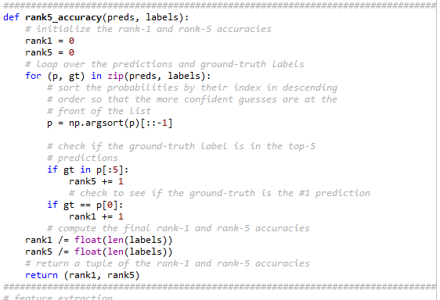
Networks as Feature Extractors
Extracting Features with a Pre-trained CNN
3. Ranked Accuracy: rank 1 and rank 5

Slide 11
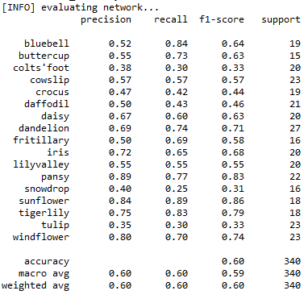
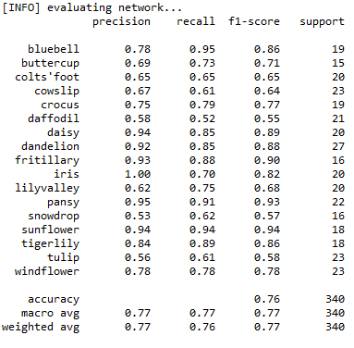
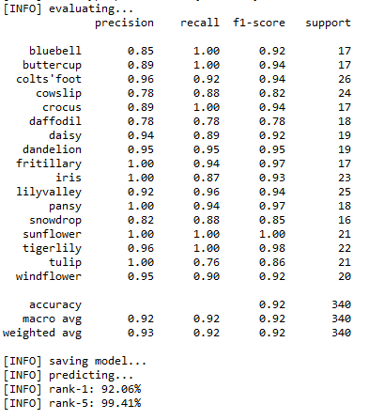
Results
MyVGG
MyVGG with Data Augmentation
Extracting Features with a Pre-trained VGG
Notes:
https://scikit-learn.org/stable/modules/generated/sklearn.metrics.precision_recall_fscore_support.html

Slide 12
Conclusion: Classification using deep learning on 4 databases
1. The CIFAR-10 dataset
https://www.cs.toronto.edu/~kriz/cifar.html
2. CALTECH-101
http://www.vision.caltech.edu/Image_Datasets/Caltech101/
3. Animals: Dogs, Cats, and Pandas
https://www.kaggle.com/ashishsaxena2209/animal-image-datasetdog-cat-and-panda
4. NEU surface defect database
http://faculty.neu.edu.cn/yunhyan/NEU_surface_defect_database.html
5. Face detection using deep learning (CMU-PIE) → Giap Binh Duong
Notes:
https://scikit-learn.org/stable/modules/generated/sklearn.metrics.precision_recall_fscore_support.html

Slide 13
Conclusion: The content of the report
1. Download the database and introduce about database
2. Do experiment on a database by MyVGG network
3. Do experiment on the database by MyVGG network with data augmentation
4. Do experiment on database by VGG pre-trained
5. Compare the results and conclusions
Notes:
https://scikit-learn.org/stable/modules/generated/sklearn.metrics.precision_recall_fscore_support.html

